Slide 1
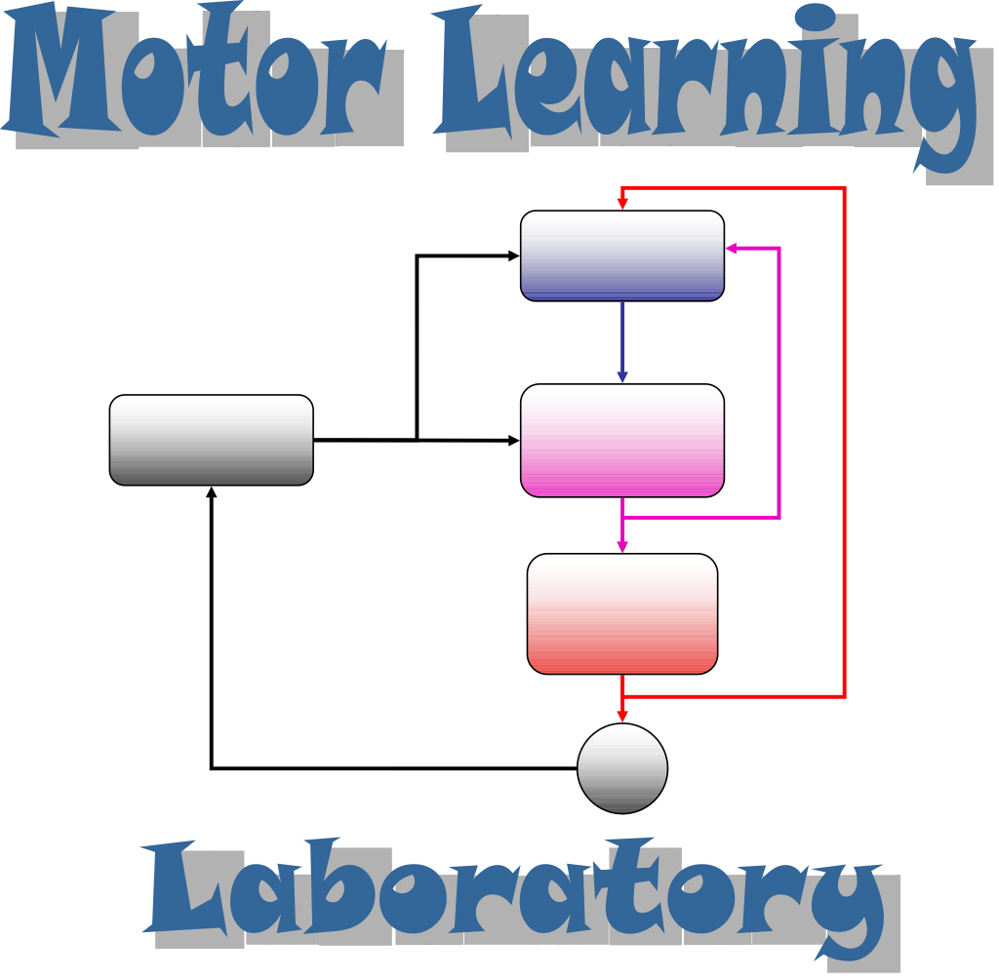
Decomposing the motor system
Ben-Gurion University
Beer-Sheva
Opher Donchin

Slide 2
Noise and learning
A bit about
  noise in the motor system
  how noise and learning are related
    Also a bit about Bayesian statistical modeling
  learning in the motor system
A surprisingly simple proposal

Slide 3
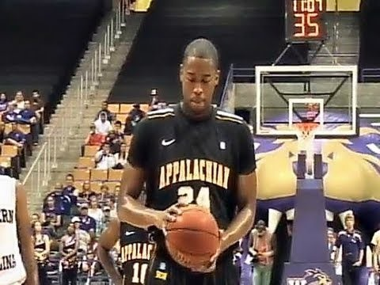
Obligatory sports video
https://www.youtube.com/embed/8dLx53NanQ0

Slide 4

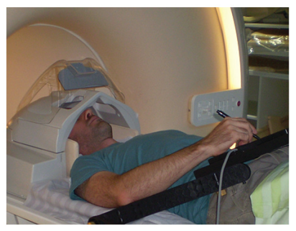
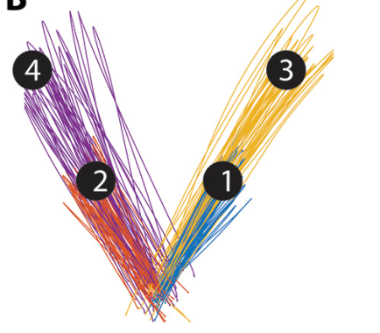
Motor noise persists in simpler situations
Haar J Neurosci 2017

Slide 5
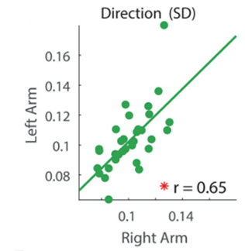
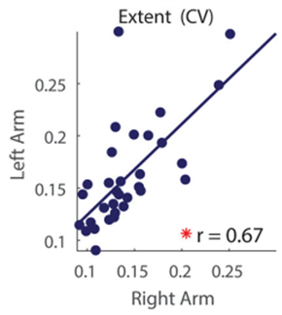
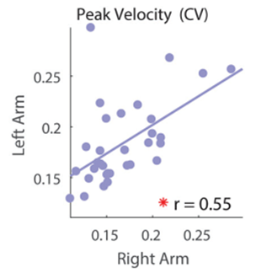
Subjects noisy using one arm are noisy in both
Haar J Neurosci 2017

Slide 6
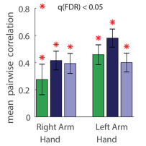

How noisy a subject is to one target predicts how noisy they are to others
Haar J Neurosci 2017

Slide 7
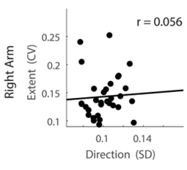
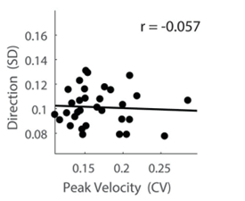
(At least) two components of noise are uncorrelated
Haar J Neurosci 2017

Slide 8
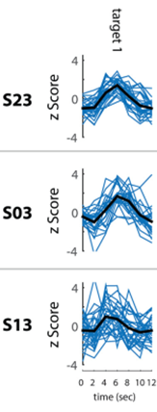
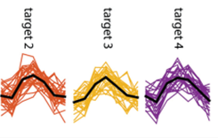
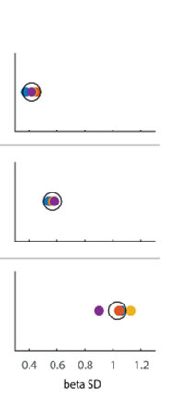
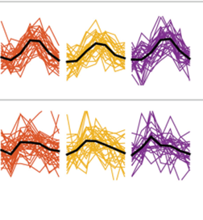
We can also characterize noise in brain activity
Haar J Neurosci 2017

Slide 9
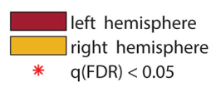
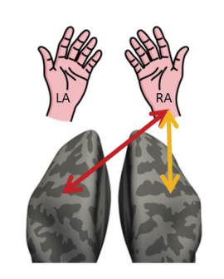





Consistency of variability is stronger contralaterally (in some areas)
Haar J Neurosci 2017

Slide 10

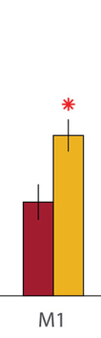


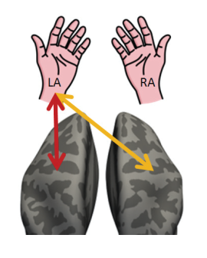

For left arm, variability is consistent in right M1 but left PMd or posterior parietal
Haar J Neurosci 2017

Slide 11
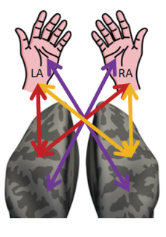
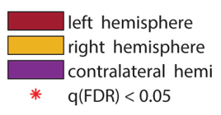

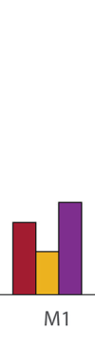

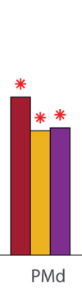

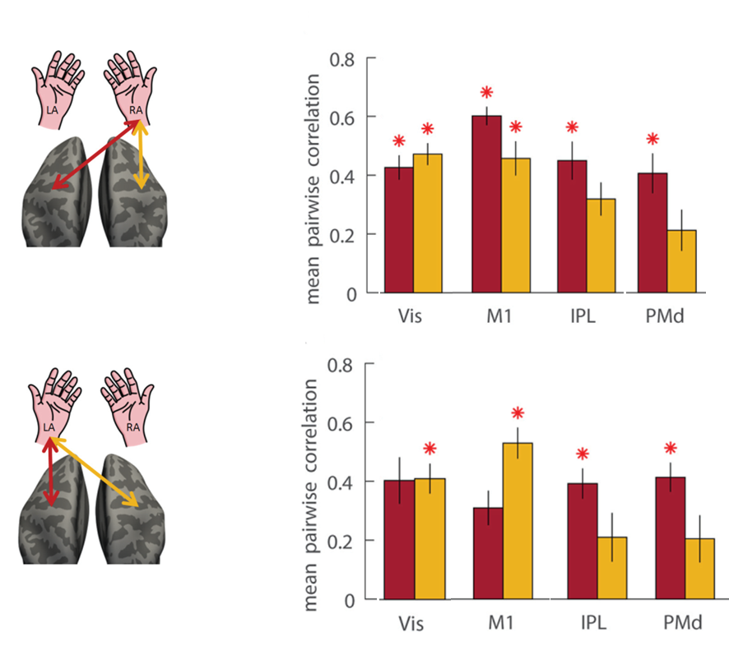
Consistency of variability across movement of the two arms
Haar J Neurosci 2017

Slide 12
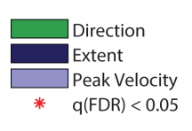

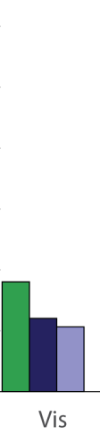

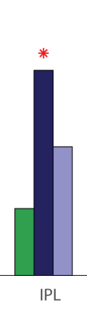

Correlation of brain variability to kinematic variability
Haar J Neurosci 2017

Slide 13
What have we learned about motor variability?
Multiple independent components
  Consistent variability within component
  No correlation across components
Some motor brain areas show consistent variability in some movements
Correlation of behavioral and neural variability in posterior parietal cortex

Slide 14
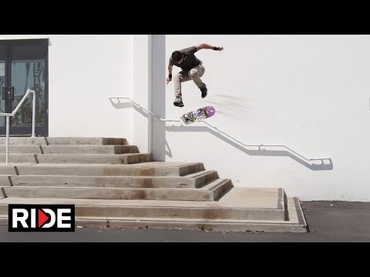
Ok. One more
https://www.youtube.com/embed/S9KE2R92pSg

Slide 15
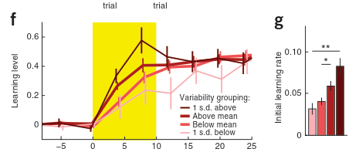
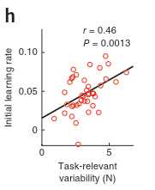
Variability is correlated to learning
Wu et al, Nature Neuroscience, 2014

Slide 16
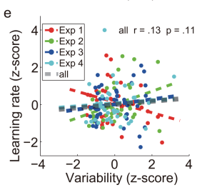
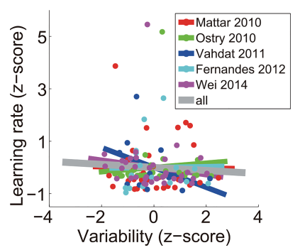
But not in all experiments
He et al, PLOS Computational Biology, 2016

Slide 17
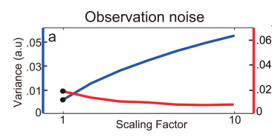
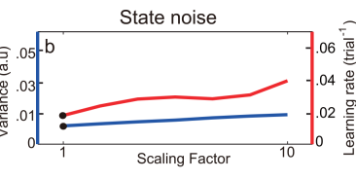






Explanation: different types of noise
Learning
Learning rate
Forgetting
Planning noise
Behavior
Execution noise
Kalman filter models predict learning will be:
Correlated with planning noise
Inversely correlated with execution nosie

Slide 18

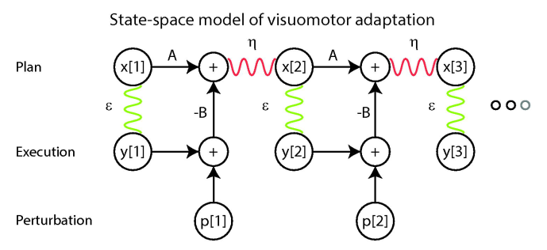
Our model of the learning process
https://www.biorxiv.org/content/early/2017/12/28/238865

Slide 19
Parameters of the model
https://www.biorxiv.org/content/early/2017/12/28/238865

Slide 20
Hierarchical model over subjects
https://www.biorxiv.org/content/early/2017/12/28/238865

Slide 21
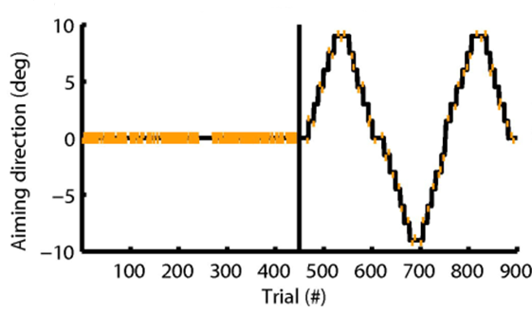
Noise and learning identified with different epochs
No visual feedback
https://www.biorxiv.org/content/early/2017/12/28/238865

Slide 22
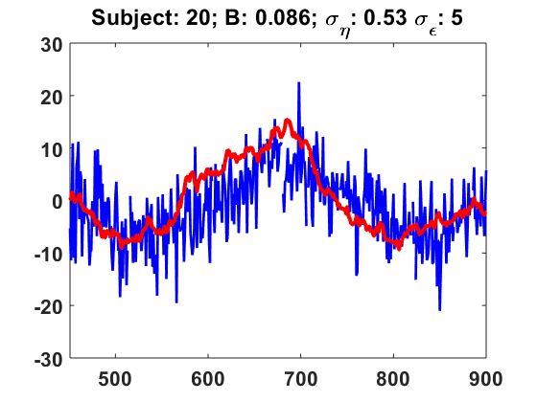
Sampling from the posterior distribution
https://www.biorxiv.org/content/early/2017/12/28/238865

Slide 23
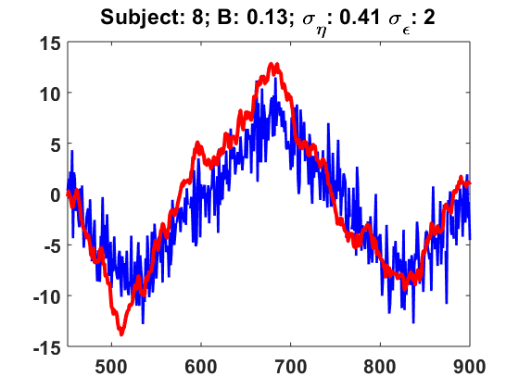
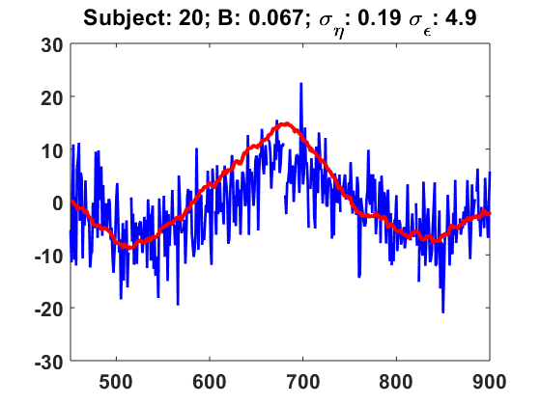
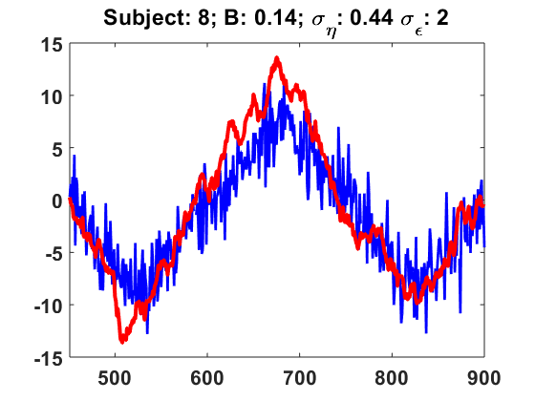
Each sample is a different full set of parameters
Chain 1, Sample 8794
Chain 2, Sample 18,836

Slide 24
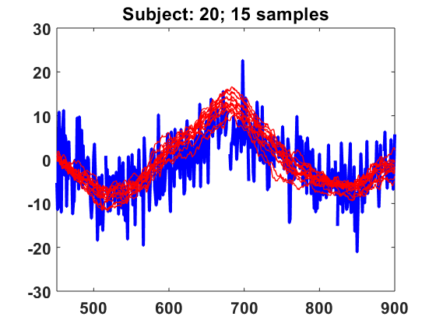
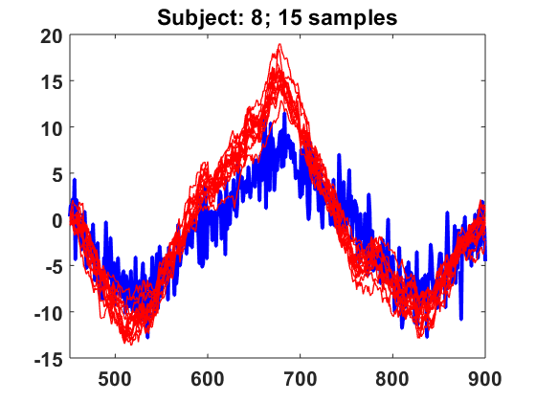
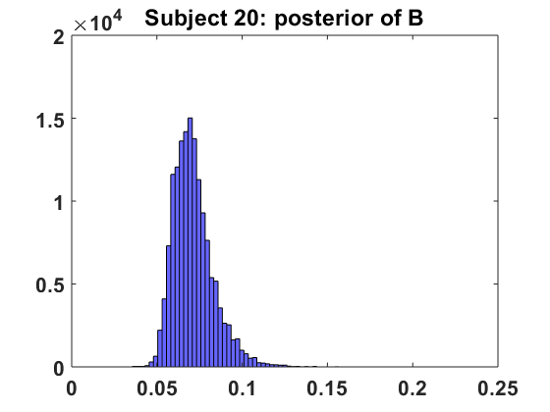
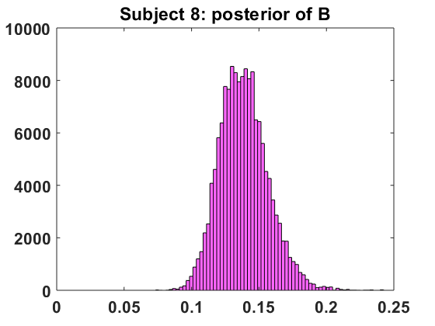
Samples together reflect shape of posterior distribution

Slide 25
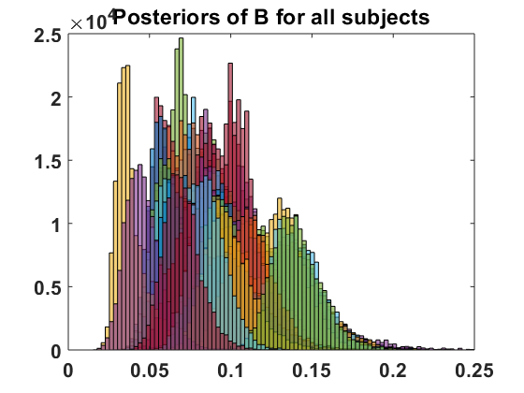
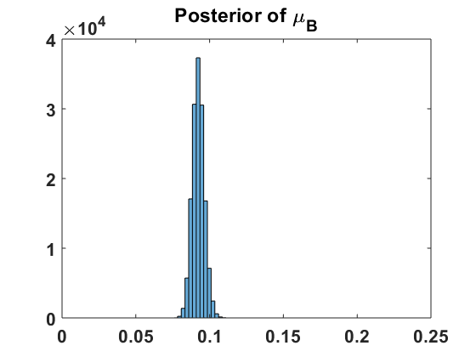
Posterior distributions of population and hyperparameter
https://www.biorxiv.org/content/early/2017/12/28/238865

Slide 26
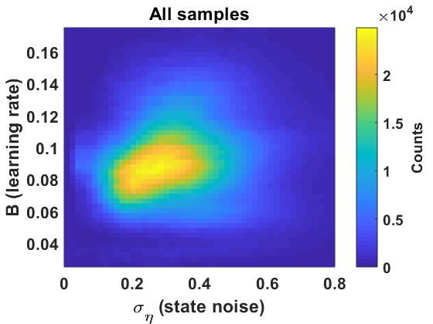
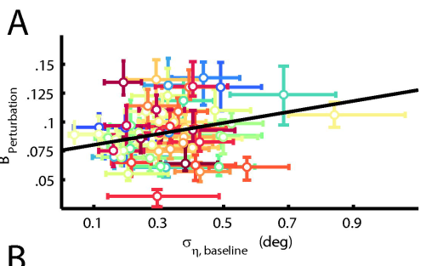
Planning noise correlated with learning
https://www.biorxiv.org/content/early/2017/12/28/238865

Slide 27
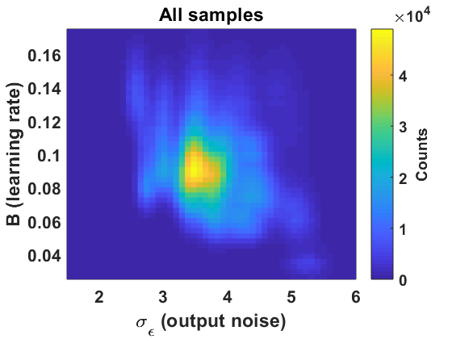
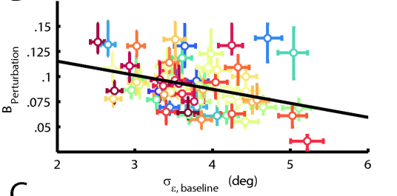
Execution noise inversely correlated
https://www.biorxiv.org/content/early/2017/12/28/238865

Slide 28
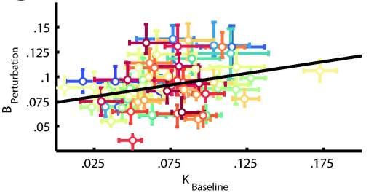

Optimal Kalman gain predicts learning
https://www.biorxiv.org/content/early/2017/12/28/238865

Slide 29
Where are we now?
Part 1
  Variability in subjects is consistent
  Correlation of learning and noise in posterior parietal
Part 2
  Learning
    correlated with state noise
    Inversely with output noise
  Predicted by Kalman optimum

Slide 30

Last one, I promise
https://www.youtube.com/watch?v=51uXMHdamb4

Slide 31


Using MRI to Localize learning
Haar J Neurosci 2015

Slide 32
Decoding movement direction from pattern of fMRI activity
Haar J Neurosci 2015

Slide 33







Many areas of cortex reflect movement
Haar J Neurosci 2015

Slide 34






After adaptation: visual, motor and parietal!
Haar J Neurosci 2015

Slide 35
Final Summary
Learning predicted by optimal Kalman gain
  Balancing state and output noise
Posterior parietal cortex
  Noise correlates with behavioral noise
  Learning changes activity patterns

Slide 36



Thanks!
Shlomi Haar
Rick Van Der Vliet
Ruud Selles, Maarten Frens and Ilan Dinstein
  Co-supervision

Slide 37

Sorry, I lied!
https://www.youtube.com/watch?v=Hmjv9KxCzZU

Slide 39



We can also simulate behavior

Slide 40



Simul

Slide 41




Slide 42



Fig 3 D-G,I: Model parameters and measurable values, results

Slide 43


Parietal areas are motor-colored visual representation
Haar J Neurosci 2015

