Slide 1
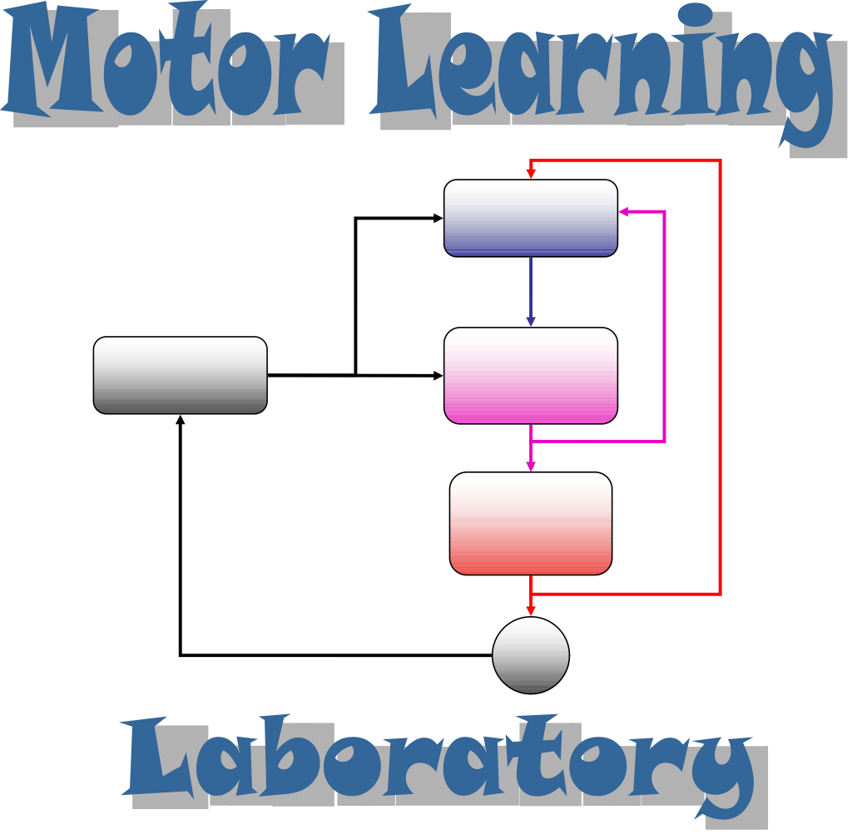
The cerebellar role in correcting reach errors:
hierarchical processing or integration
Ben-Gurion University
Beer-Sheva
Opher Donchin

Slide 2





Check out our current work!
Tonight at dinner!
Tomorrow on the hike!
Yoel Ziblat-Shay
Noise and learning in baseline movements
Zohar Bromberg
Jana Maresch
Inbal Paran
Tamar Dvir
Physiology of slow learning
Components of explicit learning
Anatomy of age-related motor deficits
Motor control in autism

Slide 3
Introduction
What are the building blocks of the motor system
Can we relate our theoretical models of motor control to the actual motor system

Slide 4
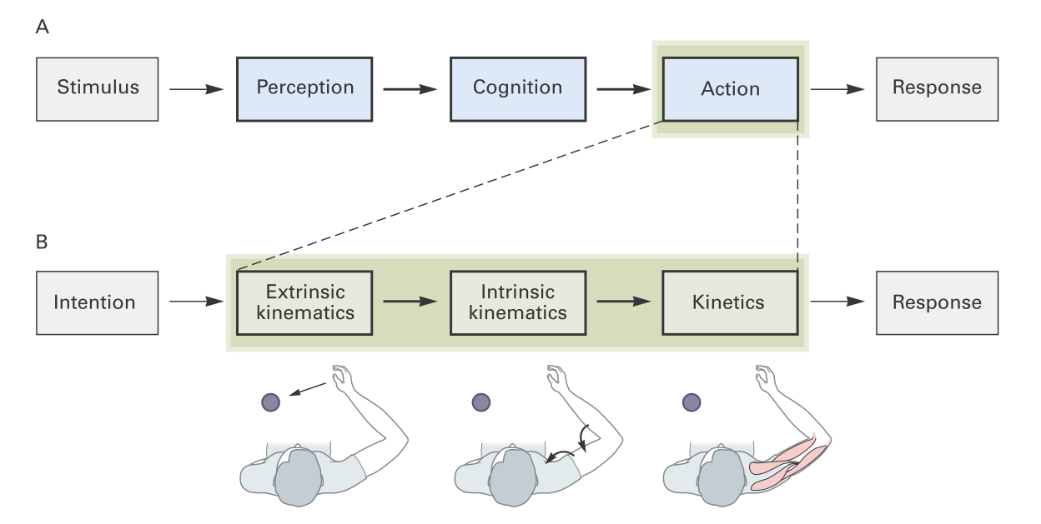
A model of the motor system
PPC
PM
MI
Kandel Schwartz, 2013

Slide 5
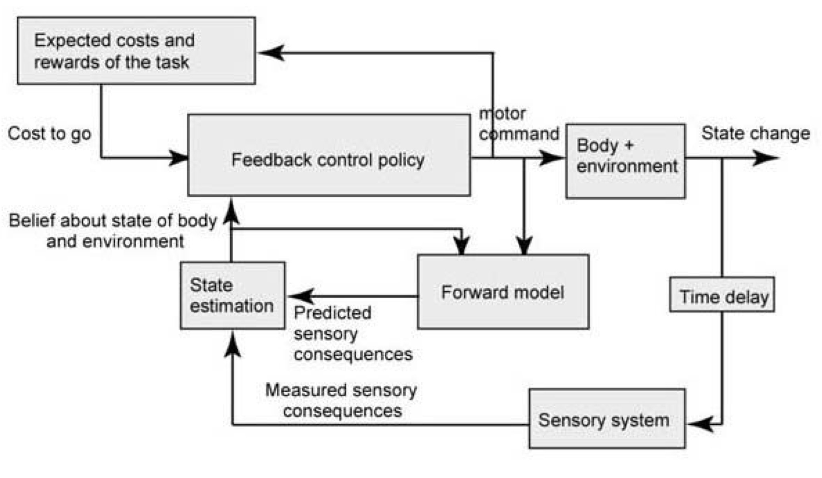
Incorporating subcortical areas
Basal ganglia
Cortex
Cerebellum
Shadmehr and Krakauer, EBR 2008

Slide 6
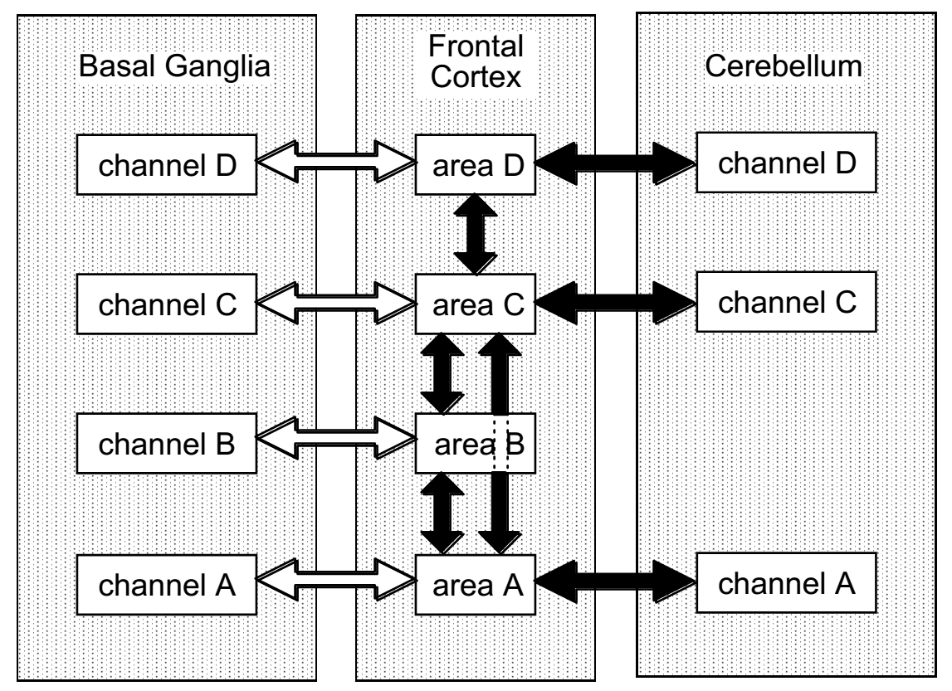
Parallel segregated loops
Basal ganglia
Cortex
Cerebellum
Houk in Frontal-subcortical Circuits in Psychiatric and Neurological Disorders 2001

Slide 7
Parallel loops with subcortical areas
Each area of cerebellum involved in a different information flow

Slide 8
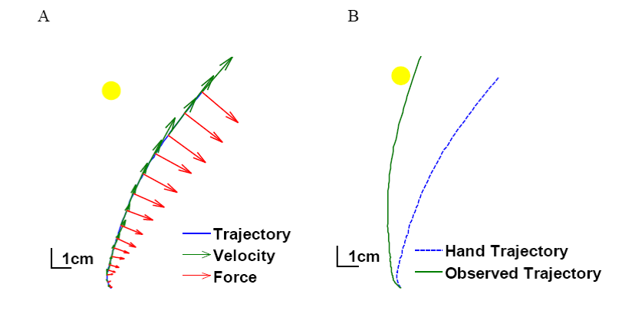
Two perturbed reaching tasks
Force field perturbation
Visuomotor adaptation

Slide 9
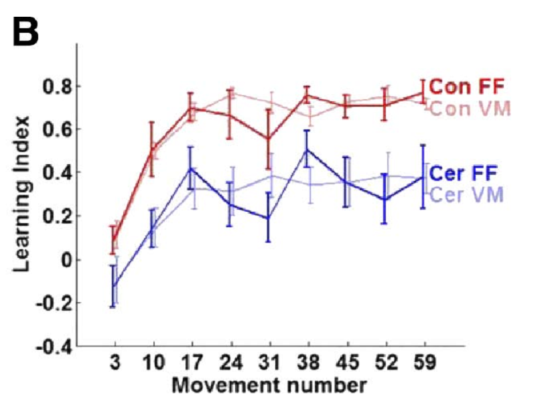

Cerebellum required for both
Patients with cerebellar degeneration
Rabe, J Neurophysiol, 2009

Slide 10
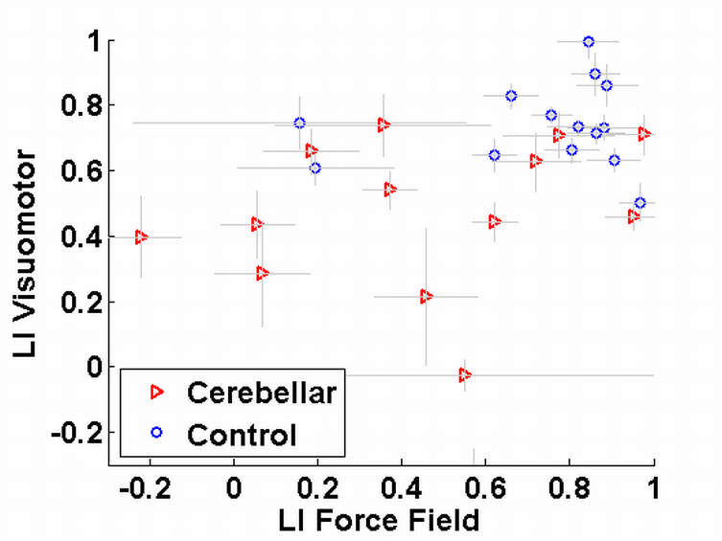
Performance uncorrelated in FF and VM
Rabe, J Neurophysiol, 2009

Slide 11
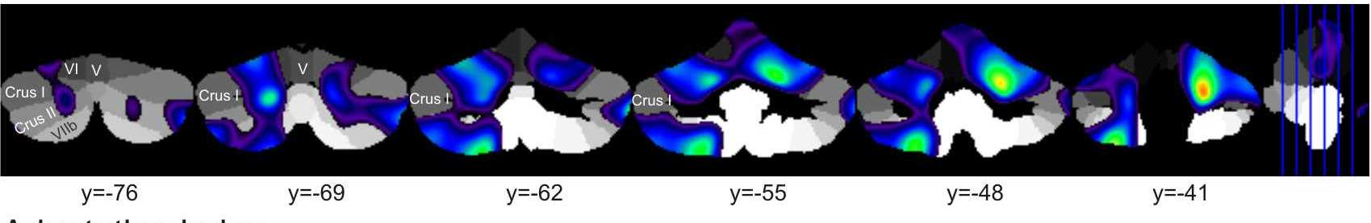
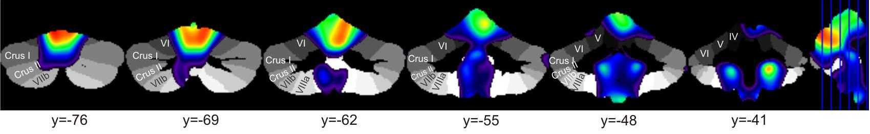
Correlation of cerebellar volume to task performance
Force field: more anterior (lobule IV-V)
Visuomotor: more posterior (lobule V-VI)
Visuomotor
Force field
Rabe, J Neurophysiol, 2009

Slide 12

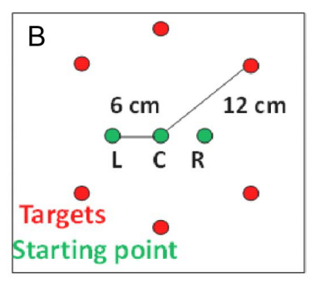
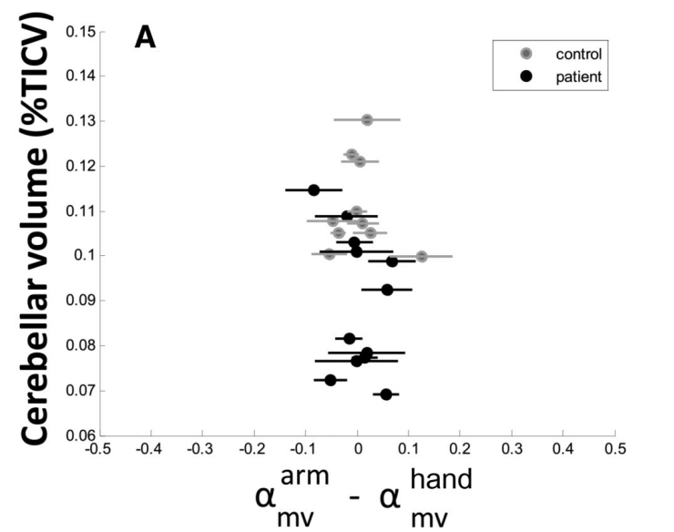
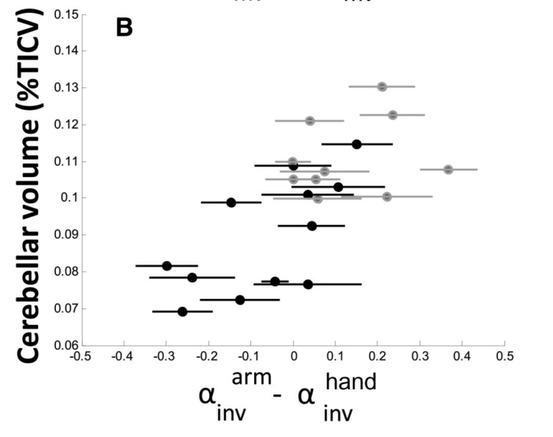
Cerebellum required to incorporate visual information
Taig, J Neurosci, 2012

Slide 13
Progressively motor caudal areas used in each task
FF
VM
Task state
Taig, J Neurosci, 2012

Slide 14
The hierarchy of control of reaching movements
Body +
environment
State change
Parietal
cortex
Premotor
cortex
Motor cortex
Crus I
Posterior anterior
cerebellum
Anterior anterior
cerebellum
Sensory system

Slide 15
Translating this insight to our understanding of cortex
What does each loop do?
How do Basal Ganglia and Cerebellum help?

Slide 16
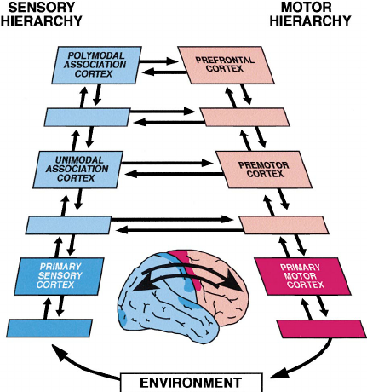
Cortical representation is a paired hierarchy
Fuster, Neuron 2001

Slide 17
A proposal
Two levels of hierarchy
  Body
  Task
Two types of predictive representation
  State
  Action

Slide 18
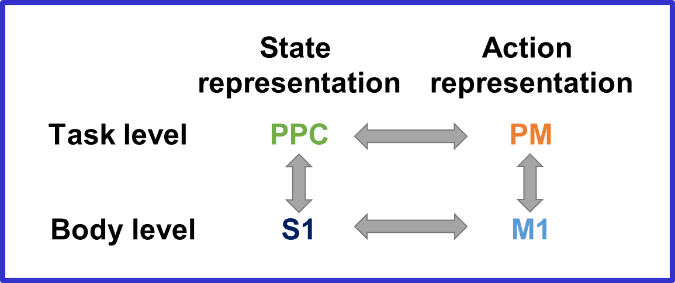
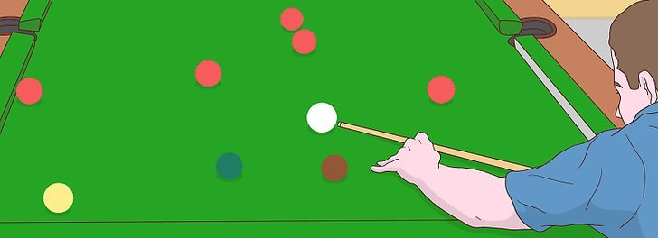
A proposal about the cortical hierarchy

Slide 19
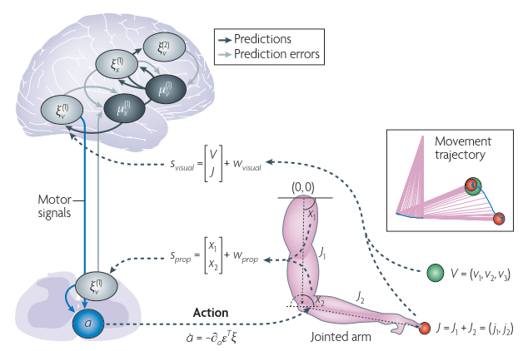
Cortical representation is predictive
Friston, Nat Rev Neuro, 2010

Slide 20
A new neuroanatomy of motor control

Slide 21
Parietal cortex in our proposal
Task state representation

Slide 22
Proposed roles for parietal cortex
Visuo-motor integration
  Richard Andersen
State estimation
  Integrated model
  Daniel Wolpert
We propose: representation of task state

Slide 23

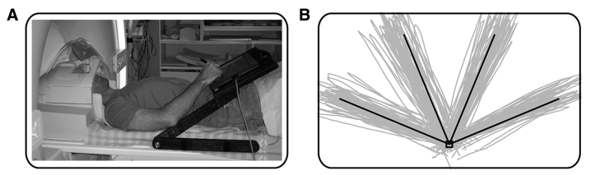
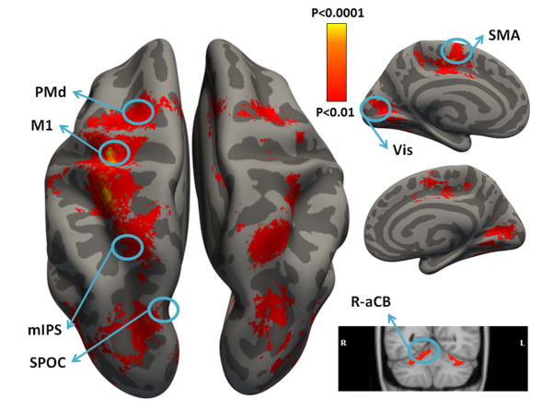
Look at movement in the MRI
Haar J Neurosci 2015

Slide 24
Decoding movement direction from pattern of fMRI activity
Haar J Neurosci 2015

Slide 25
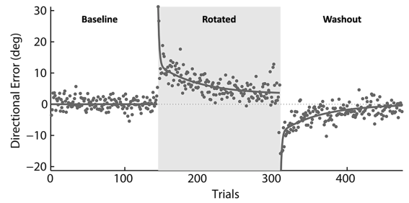
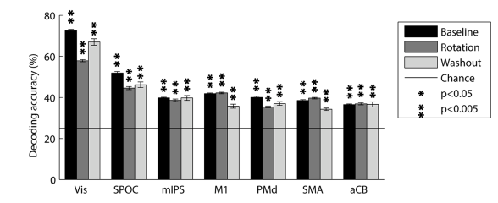
Many areas of cortex reflect movement
Haar J Neurosci 2015

Slide 26
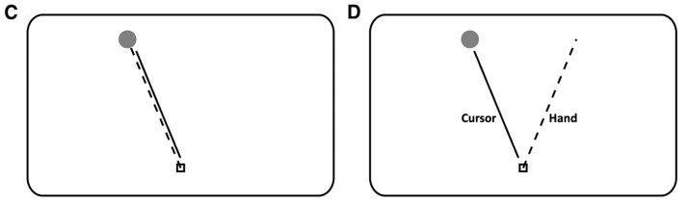
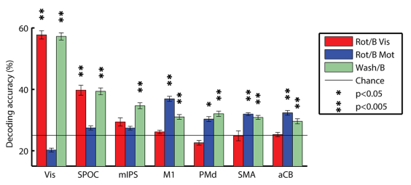
After adaptation: visual, motor and parietal!
Haar J Neurosci 2015

Slide 27

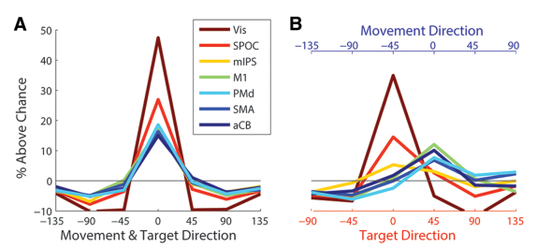
Parietal areas are motor-colored visual representation
Haar J Neurosci 2015

Slide 28
Premotor cortex in our proposal
Task action representation

Slide 29
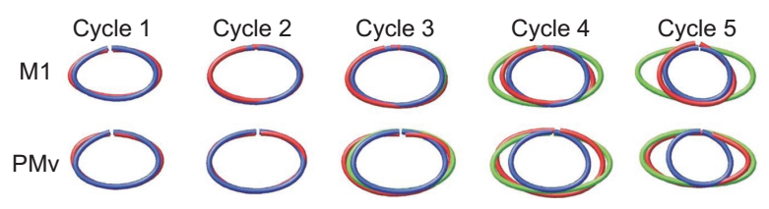
Premotor role in state action
Blue: hand trajectory
Green: cursor trajectory
Red: neural trajectory
Schwartz, 2004

Slide 30
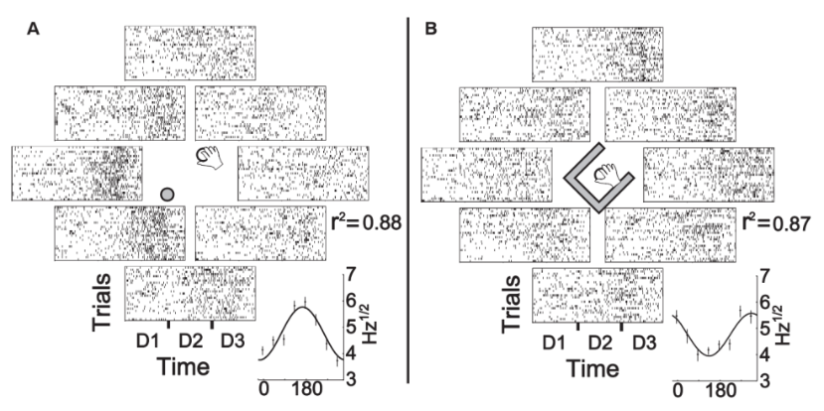
Pre-motor neurons coding for task action
Pearce and Moran, 2012

Slide 31
Interaction of pre-motor and parietal cortex
Bidirectional flow of information

Slide 32
Interaction of pre-motor and parietal cortex
Bidirectional communication

Slide 33
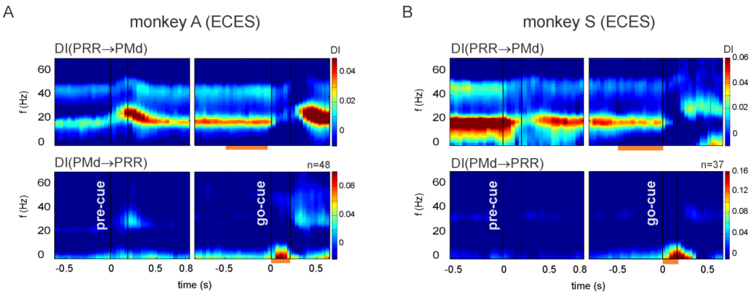
Information flow from PM to Parietal changes direction during task
Martinez-Valquez and Gail, Cerebral Cortex, 2018

Slide 34
Summary
Parallel segregated loops with subcortical areas
Cortical role in predictive representation of dynamics
  Task / body : low vs. high
  State / action: frontal vs. parietal
Subcortical areas subserve specific cortical needs

Slide 35
Thanks!
Shlomi Haar
  Ideas and data
Alex Gail and Ilan Dinstein
  Useful discussions
Dagmar Timann
  Fruitful collaboration
Reza Shadmehr
  Support and advice

Slide 36
Check out our current work!
Tonight at dinner!
Tomorrow on the hike!
Yoel Ziblat-Shay
Noise and learning in baseline movements
Zohar Bromberg
Jana Maresch
Inbal Paran
Tamar Dvir
Physiology of slow learning
Components of explicit learning
Anatomy of age-related motor deficits
Motor control in autism

